Slide 1
Data Based
Problem Solving
🏛️ Data Science in Architecture 🏛️

Slide 2










Materials
Challenge

Slide 3

1 - 2 - 4 - Full Group
1 min: Think through it on your own.
2 min: With a partner, share your solution (1 min each).
4 min: With another pair, share your solutions ( 1 min each).
Full Group: Present best solution and share the different options that group members contributed.

Slide 4
🏛️ The Architect and the Materials 🏛️
An architect must transport a column, a beam, and a bundle of wood across a river to build a bridge. They have a small ferry that holds only the architect plus one item.
However:
The beam is unstable and will topple over if left alone with the column.
The bundle of wood is prone to mold and will ruin the column if left alone together.
How does the architect ferry all three materials safely across the river?

Slide 5

🏛️ The Architect and the Materials 🏛️
An architect must transport a column, a beam, and a bundle of wood across a river to build a bridge. They have a small ferry that holds only the architect plus one item.
However:
The beam is unstable and will topple over if left alone with the column.
The bundle of wood is prone to mold and will ruin the column if left alone together.
How does the architect ferry all three materials safely across the river?
Individually
In Pairs
Groups of 4

Slide 6
NOW
SHARING

Slide 7


Solution
Final Moves Summary:
Take Column across
Return alone
Take Beam across
Bring Column back
Take Wood across
Return alone
Take Column across

Slide 8





Effective
Project
Scheduling
Take notes!

Slide 9

Dynamic:
Well-Managed:
Current:

Slide 10


Weather
data

Slide 11
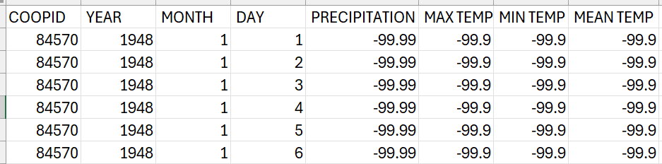
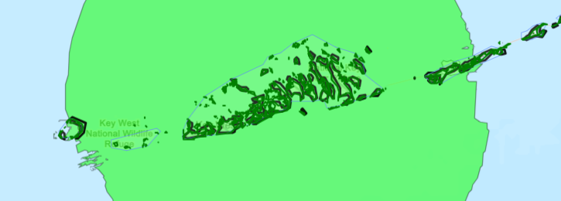
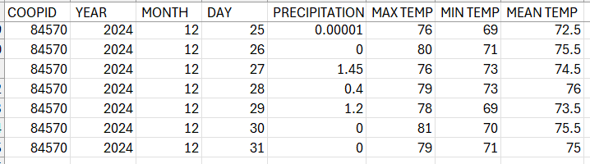
Raw Data
Key West, FL
Station

Slide 12
Google Colab? Data Analysis

Slide 13
Timeline examples, requirements

Slide 14
Presentation Expectations

